Slide 1
Precedence and Associativity of Operators
Lecture-5(Part-2)Operators

Slide 2

Precedence of Operators
The precedence of operators determine a rank for the operators. The higher an operator's precedence or priority,
Example: So how the expression a * b + c will be interpreted?
(a * b) + c or a * (b + c),
here the first interpretation is the one that is used because the multiplication operator has higher precedence than addition.

Slide 3
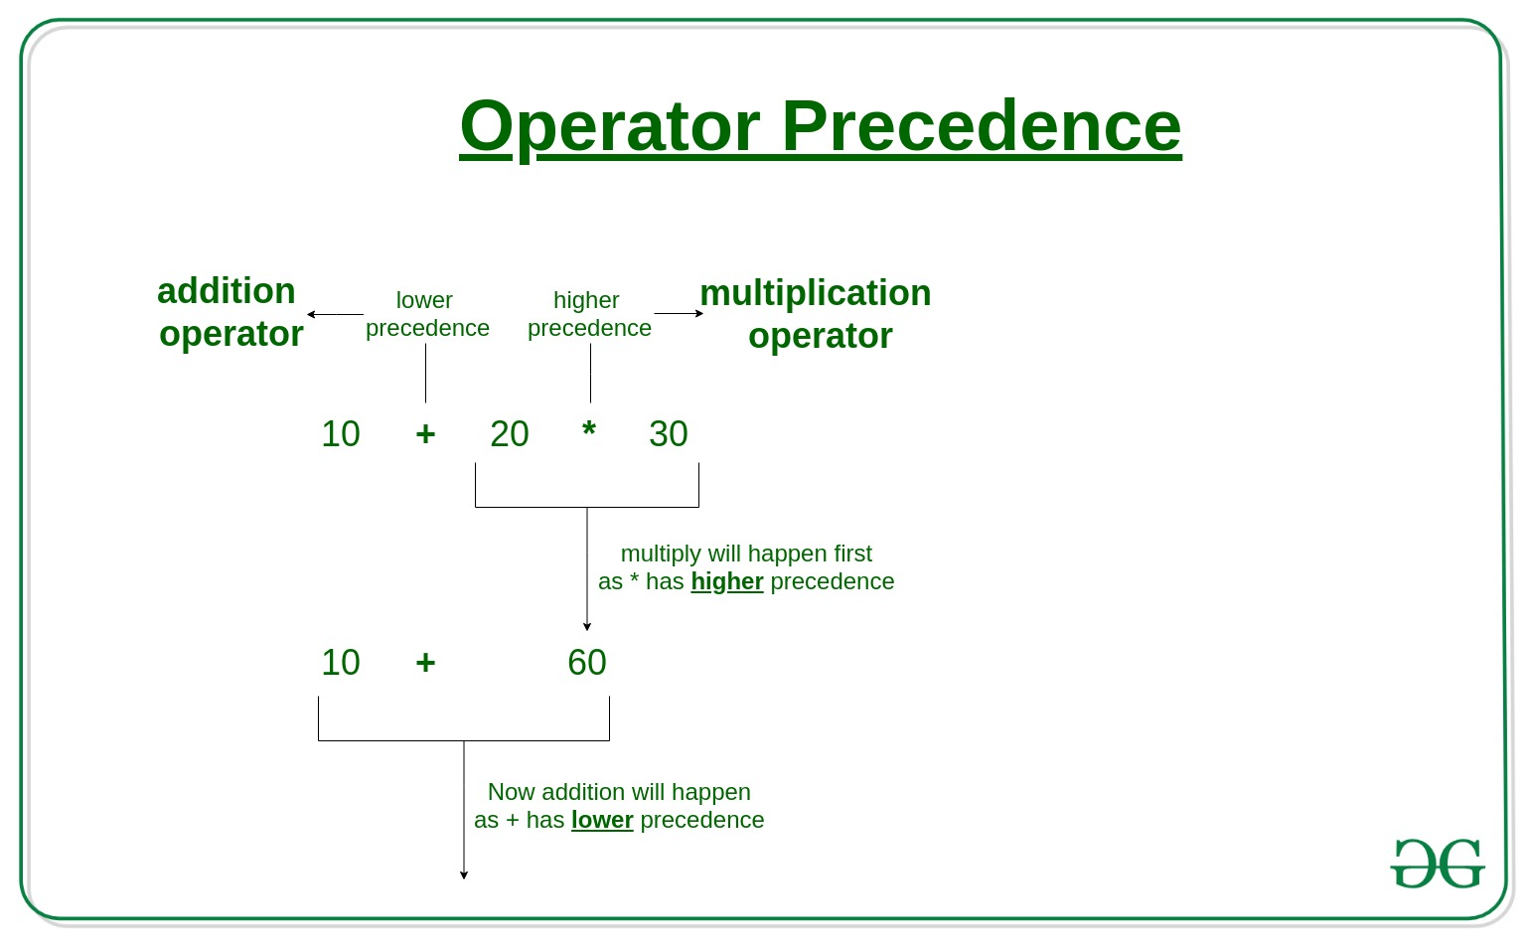
Precedence-Example

Slide 4
Associativity of Operators
Associativity tell us the order in which several operators with equal precedence are computed or processed in two directions, either from left to right or vice-versa.
Example: In the expression
a * b / c,
since multiplication and division have the same precedence we must use the associativity to determine the grouping. These operators are left associative which means they are grouped left to right as if the expression was
(a * b) / c.

Slide 5
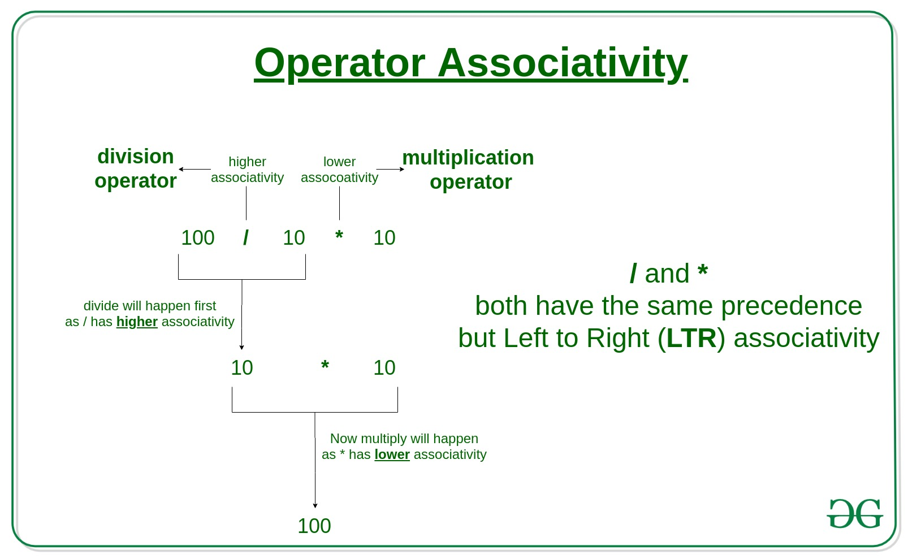
Associativity-Example

Slide 6
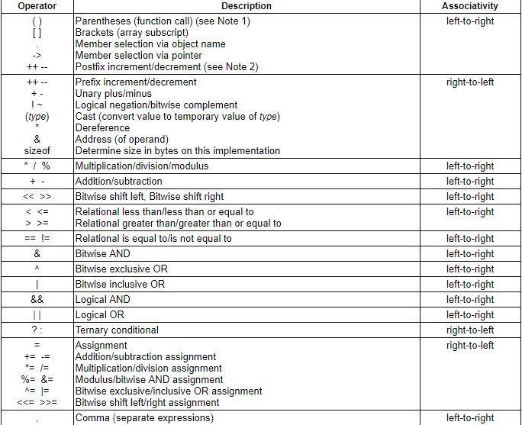


Slide 7
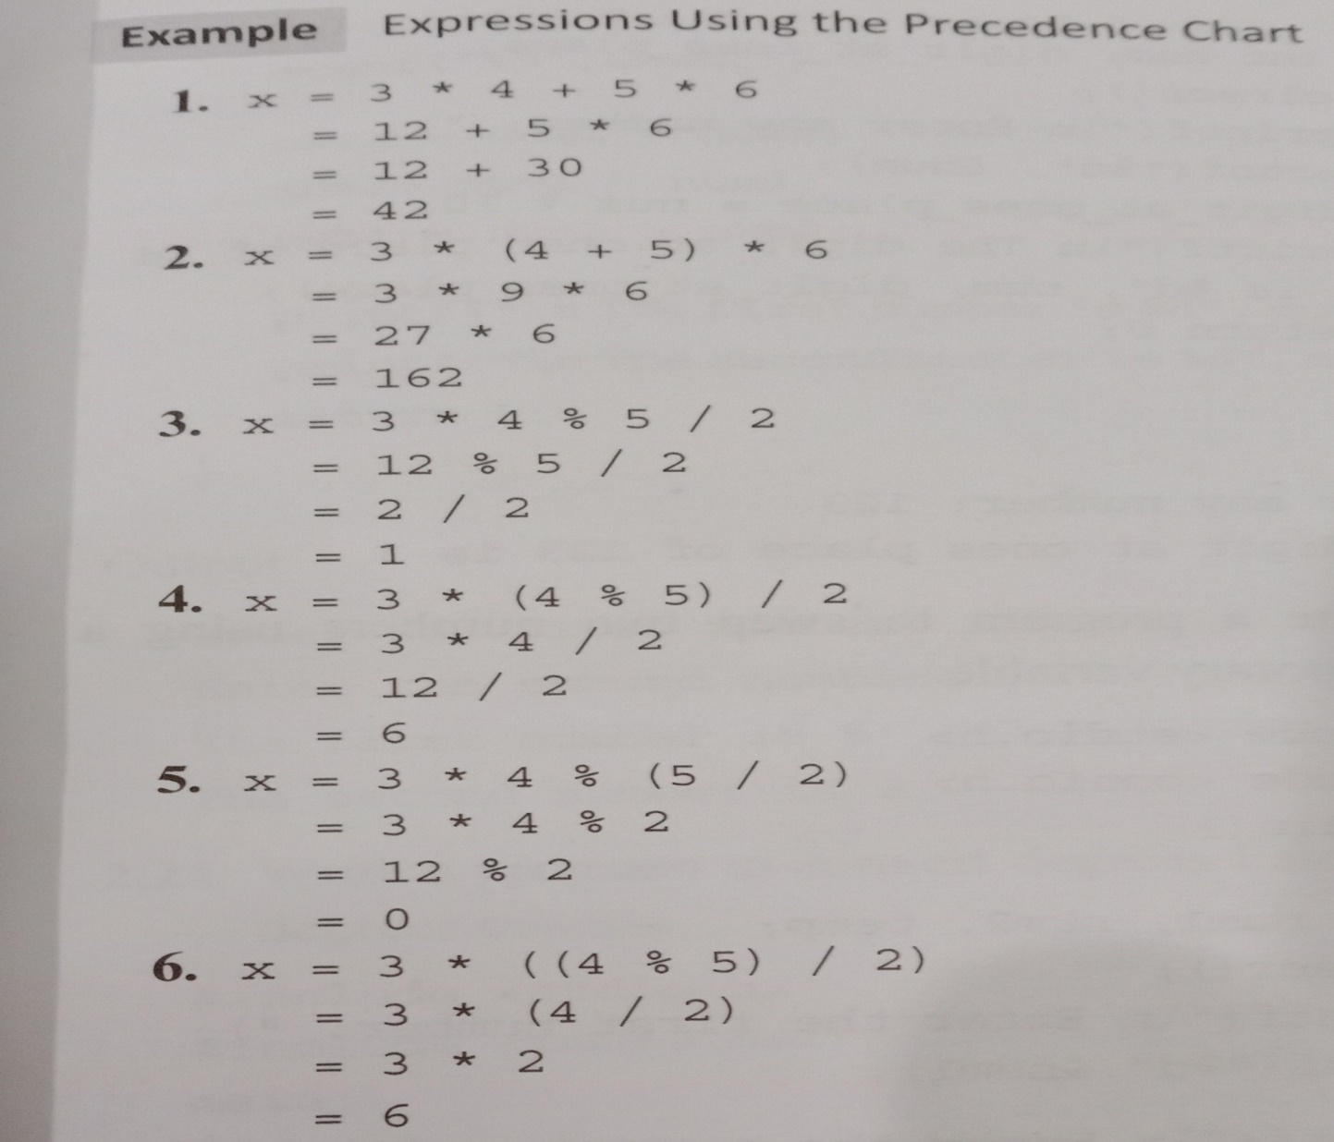
Consider
int a=0,b=1,c=-1
float x=2.5,y=0.0

Slide 8
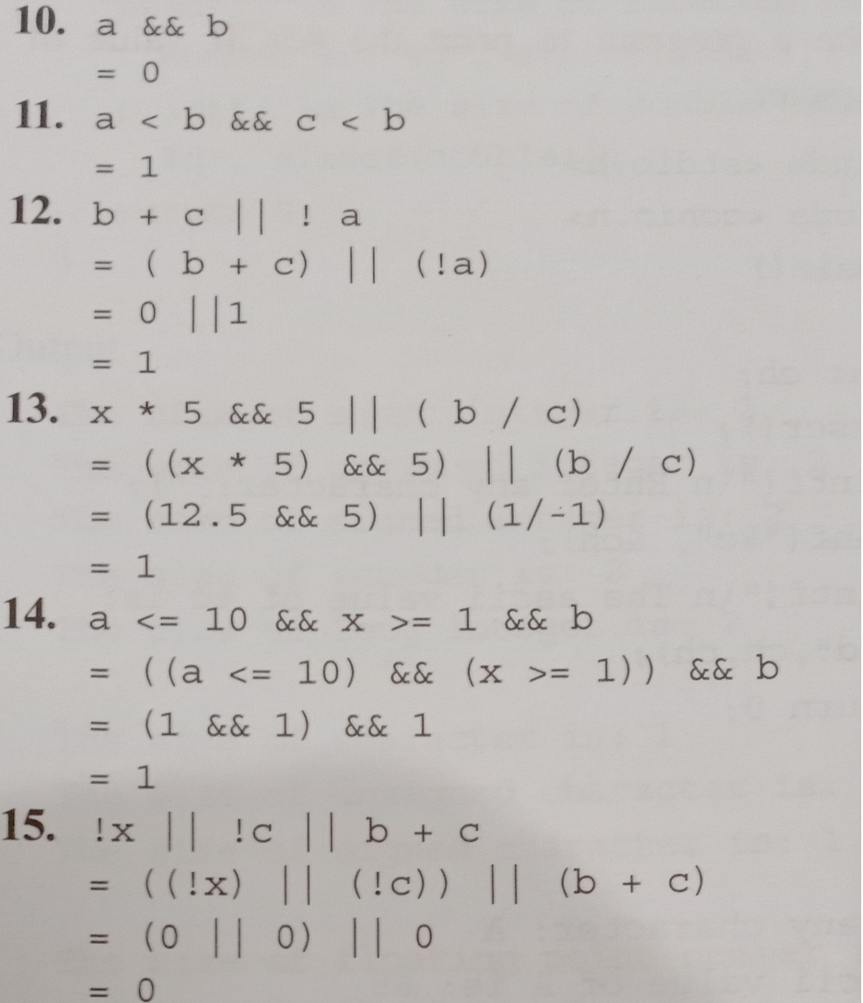
Consider
int a=0,b=1,c=-1
float x=2.5,y=0.0

Slide 9
Practice questions(Q1)
#include <stdio.h>
int main()
{
double b = 5 % 3 & 4 + 5 * 6;
printf("%lf", b);
return 0;
}
2
30
2.000000
5
Notes:
C

Slide 10
(Q2)
#include <stdio.h>
int main()
{
double b = 3 && 5 & 4 % 3;
printf("%lf", b);
return 0;
}
A. 3.000000 B. 4.000000 C. 5.000000
D. 1.000000
Notes:
D

Slide 11
(Q3)
What will be the output of the following C code?
#include <stdio.h>
int main()
{
double b = 5 & 3 && 4 || 5 | 6;
printf("%lf", b);
return 0;
}
A. 1.000000
B. 0.000000
C. 7.000000
D. 2.000000
Notes:
A

Slide 12
(Q4)
What will be the output of the following C code?
#include <stdio.h>
int main()
{
int b = 5 + 7 * 4 - 9 * (3, 2);
printf("%d", b);
}
6
15
13
21
Notes:
B

Slide 13
(Q5)
What will be the output of the following C code?
#include <stdio.h>
int main()
{
int b = 4 * 6 + 3 * 4 < 3 ? 4 : 3;
printf("%d\n", b);
}
3
33
34
4
Notes:
A

Slide 14
(Q6)
Which of the following operators has an associativity from Right to Left? A. <= B. << C. == D. +=
Notes:
D

Slide 15
(Q7)
What will be the output of the following C code?
#include <stdio.h>
int main()
{
int a = -1, b = 4, c = 1, d;
d = ++a && ++b || ++c;
printf("%d, %d, %d, %d\n", a, b, c, d);
return 0;
}
A. 0, 4, 2, 1
B. 0, 5, 2, 1
C. -1, 4, 1, 1
D. 0, 5, 1, 0
Notes:
A

